Slide 1
L16 F&P of CSI
Service Strategy
Processes involved
  Steps in improvement process
Service Reporting
  Activities involved
  Contents of reporting framework
Service Design
Service Transition
Service Operation
Continual Service Improvement

Slide 2
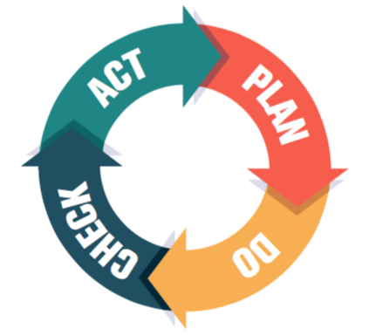
Learning outcome:
Student will be able to:
Describe the 7 steps for improvement
Describe the techniques for service reporting

Slide 3
*Goals and Objectives
The goal of CSI is for continual improvement of the effectiveness and efficiency of IT services.
Aims to achieve and surpass the objectives (effectiveness), and obtain these objectives at the lowest cost possible (efficiency).
How ? By measuring and analyzing process results in all Service Lifecycle phases, to determine which results are structurally worse than others. These offer the highest improvement probability.

Slide 4
Goals and Objectives
CSI mainly measures and monitors the following areas:
  Process compliance – Does the organization follow the new or modified service management process
  Quality – Do the various process activities meet their goals?
  Performance – How efficient is the process? What are the elapsed times?
  Business value of a process – Does the process make a difference? Is it effective? How does the client rate the process?

Slide 5
*CSI improvement process
The CSI improvement process or 7-step improvement process describe how to measure and report.
Improvement take place according to P-D-C-A cycle.
The CSI plan phase results in a service improvement Plan (SIP)

Slide 6
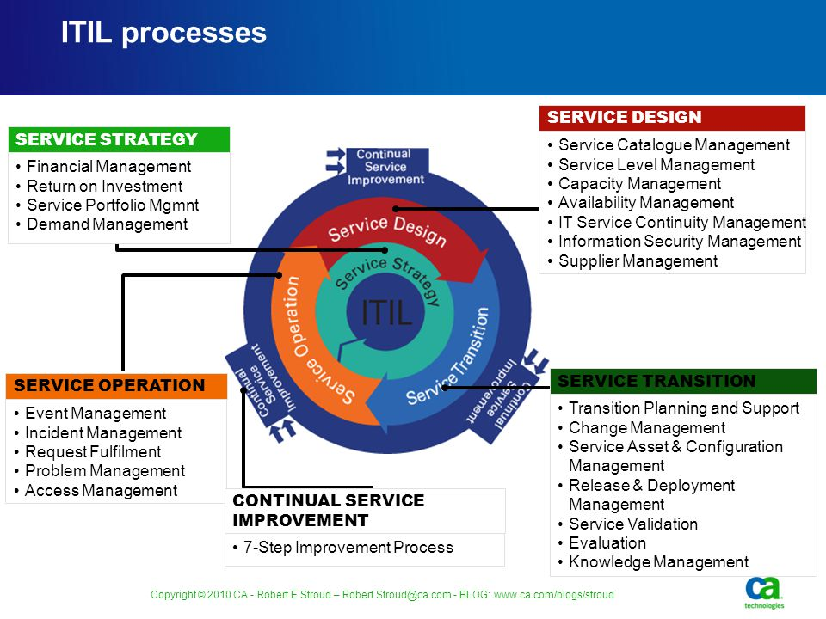

Slide 7
7 steps from measurement to improvement
1 Define target measurements
Implement corrective actions
2 Indentify what can be measure
6 Present data
3 Gather data
5 Analysis Data
4 Process data

Slide 8
7 steps from measurement to improvement
What should you measure? – what would be the ideal situation? This must follow from the vision and precede the assessment of the current situation
What can you measure? – this step follows from phase III of the CSI model : where do we want to be? By researching what the organization can measure, it will discover new business requirements and new IT options. By using gap analysis CSI can find areas for improvement and plan these

Slide 9

7 steps from measurement to improvement
Gather data (measure) – in order to verify whether the organization has reached its goal, it must perform measurements. The measurement must follow from its vision, mission, goals and objectives
Process data – the processing of data is also necessary for monitoring purposes. This must happen according to CSFs and KPIs determined

Slide 10
7 steps from measurement to improvement
Analyze data – discrepancies, trends and possible explanations are prepared for presentation to the business.
Present and use information – this is where the stakeholder is informed whether his goals have been achieved
Implementation corrective action – Create improvements, establish a new baseline and start the cycle from the top

Slide 11

Service Reporting
The service reporting process is the process which is responsible for generation and supply of reports about the results achieved and the developments in service level

Slide 12
Activities, method and techniques
The service reporting process distinguishes the following activities:
  Gather data
  Process the data into information and apply this to the organization publish the information
  Fine-tune the reporting to the business

Slide 13
F&P of continual service improvement ( Review Questions )
Q1 What are the 4 areas that CSI should measure and monitor?
Q2 List the 7 steps of the continual service improvement process.
Q3 State the interests of 2 groups of people within an organization that CSI report should be refined?

Slide 14
Revision MCQ
1 The first step of CSI is _____________.
Gather data
Identify what can be measured
Define target measurements
Process data
2 The main value of CSI is to _____________.
appraise performance of IT support staff
monitor the quality of work done by staff
increase profits generated by IT services
create a life-long learning culture for staff

